Slide 1

Pollution Data Analysis and Insights from different monitoring stations across India.
This presentation will present the findings of a comprehensive analysis of pollution data, revealing insights and providing valuable recommendations for environmental planning and mitigation strategies.
Notes:
This presentation analyzes pollution data from monitoring stations across India to extract insights for better environmental planning.

Slide 2

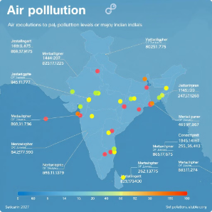
Introduction
Objective
Dataset Overview
To analyze pollution data and extract meaningful insights for effective environmental planning.
The dataset encompasses key pollution metrics such as pollutant types and levels, covering multiple cities and states with timestamps for temporal analysis.
Notes:
Our goal is to find meaningful insights from pollution data covering multiple cities and states. The dataset includes pollutant types and timestamps for trend analysis.

Slide 3
Data Cleaning and Preprocessing
Missing Data Handling
1
2
Datetime Conversion
3
Data Consistency
Rows with incomplete pollutant values were removed to ensure data integrity.
The \`last\_update\` column was converted to a proper datetime format for accurate time-series analysis.
The dataset underwent rigorous checks to ensure consistency and accuracy, crucial for meaningful visualizations and insights.
Notes:
We cleaned the data by removing incomplete rows, converted timestamps for analysis, and checked for consistency to ensure accurate results.

Slide 4



Summary Statistics
1
Key Metrics Extracted
Insights from Summary Statistics
2
Average, minimum, and maximum pollution levels were calculated for each city and state, providing a high-level view of pollution levels across different regions.
These statistics served as a foundation for deeper analysis and visualizations, providing valuable insights into the overall pollution landscape.
Notes:
We calculated average, minimum, and maximum pollution levels for different regions. These statistics help us understand overall pollution patterns.

Slide 5

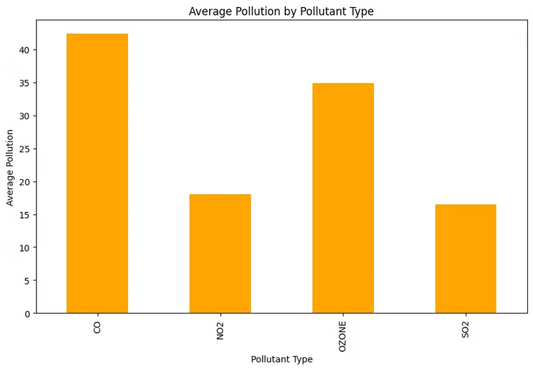
Pollutant Prevalence
1
CO Dominance
2
Ozone Prevalence
Carbon Monoxide (CO) has the highest average pollution levels across all pollutants, highlighting its significance.
Ozone is the second most prevalent pollutant, followed by relatively lower levels of NO2 and SO2.
3
Mitigation Strategies
Understanding the prevalence of different pollutants helps in targeting specific mitigation strategies for each type.
Notes:
Carbon Monoxide (CO) is the most significant pollutant, followed by Ozone. Knowing this helps us focus on reducing specific pollutants.

Slide 6

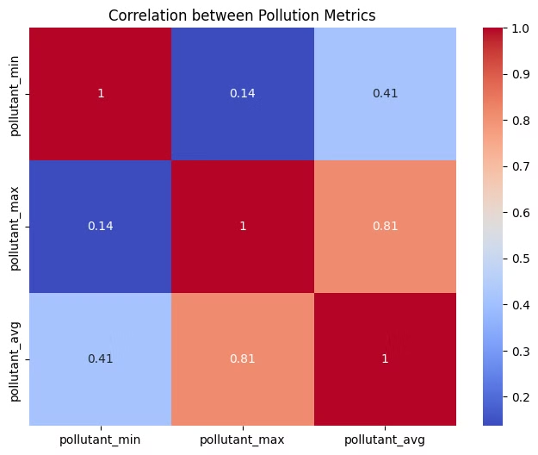
Correlation Analysis
1
Strong Positive Correlation
2
Weak Correlation
The weak correlation between \`pollutant\_min\` and other metrics suggests variability in low-level pollution.
A strong positive correlation (0.81) exists between \`pollutant\_max\` and \`pollutant\_avg\`, indicating that areas with high average pollution levels are likely to experience high peaks.
Notes:
Pollutant max and average levels show a strong positive correlation, indicating high average areas often experience peaks. Weak correlations with min levels show variability in low pollution levels.

Slide 7

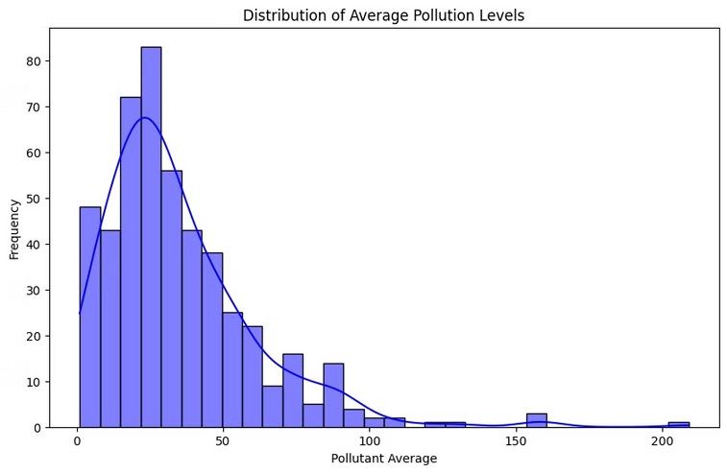
Pollution Level Distribution
1
Right-Skewed Distribution
2
Pollution Peak
A peak in pollution levels is observed in the 30-50 range, indicating a higher concentration of pollution in this area.
The distribution of average pollution levels is right-skewed, with most values falling between 0 and 50, suggesting a concentration of pollution in the lower range.
Extreme Pollution Events
3
Rare but significant outliers (>150) indicate extreme pollution events that require focused attention and mitigation strategies.
Notes:
Pollution levels are mostly low, but we observe a peak in the 30-50 range. Some extreme events with levels above 150 need urgent attention.

Slide 8
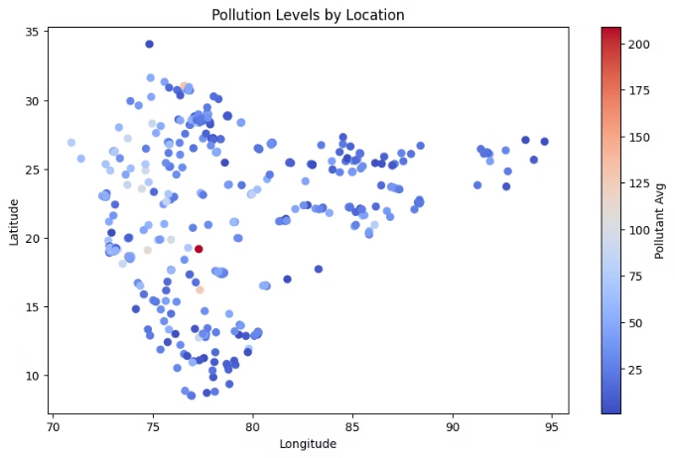
Advanced Analysis
Trend Analysis
Hypothesis Testing
Time-series analysis was conducted to uncover trends in pollution levels, identifying seasonal or monthly patterns, which can inform mitigation strategies.
A hypothesis test comparing pollution levels between two states revealed a significant difference, confirming the findings with t-statistic and p-value.
Notes:
Time-series analysis reveals seasonal pollution patterns, and hypothesis testing shows significant differences in pollution between two states.

Slide 9
Recommendations and Conclusion
Key Findings
Recommendations
CO is the most prevalent pollutant, followed by Ozone. Strong correlations provide a basis for predicting pollution levels and focusing on mitigation. High pollution outliers (>150) need focused monitoring and intervention.
Target CO and Ozone emission reduction through stricter regulations. Implement monitoring systems in high-pollution regions to prevent severe pollution spikes. Use predictive analysis to design early-warning systems for high pollution levels.
Notes:
We suggest targeting CO and Ozone reduction, implementing monitoring systems for high-pollution regions, and predictive models for early warnings.

Slide 10


References
Tools and Libraries Used
1
Dataset
2
Pollution Data Analysis and Insights different monitoring stations across India.. Provide the dataset source.
Python (Pandas, Matplotlib, Seaborn), Excel.
Notes:
This slide lists our data sources and tools like Python, Pandas, and Matplotlib, which we used for data cleaning and analysis.

Slide 11
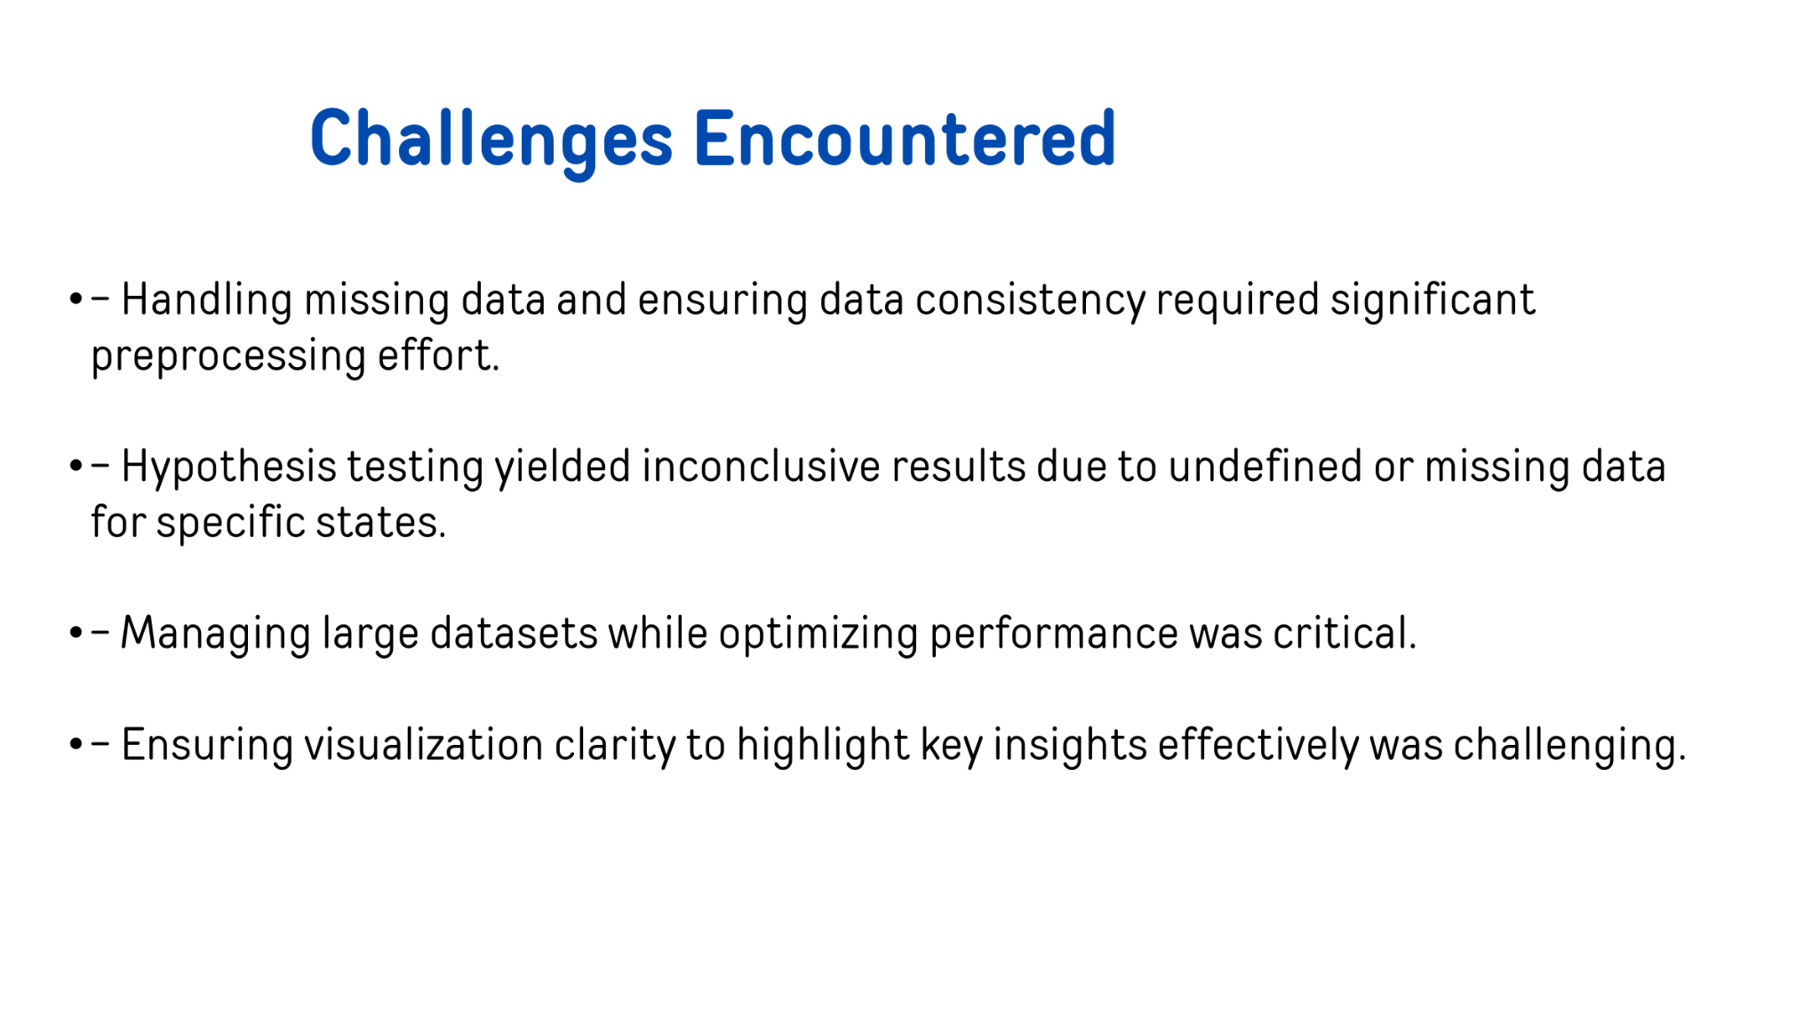

Slide 12
